Slide 1



CARBON CAPTURE
WEEK 2
Different Types of Carbon Capture Technology and processes.

Slide 2


Let's spell it out!
TOPIC OUTLINE
Day1- Post Combustion Capture Technology of Carbon Capture
Day2- Oxy Fuel Combustion Capture System
Day3- Pre Combustion Capture System
Day4 -New Future Technologies

Slide 3

DAY - 3
Oxy Fuel Combustion Capture System

Slide 4
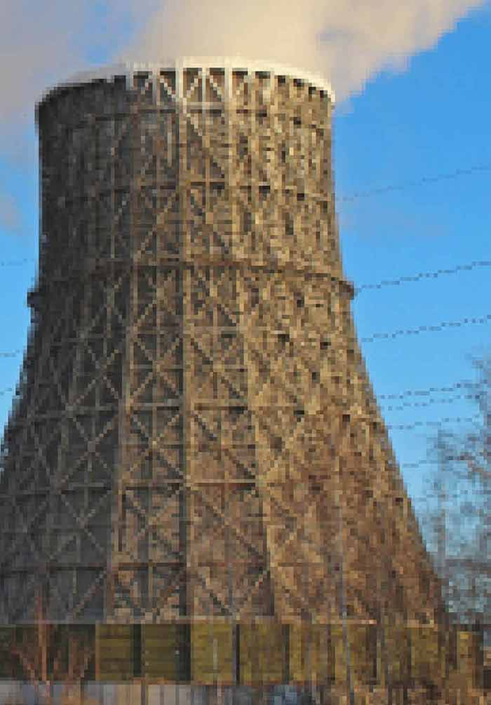

In the so-called oxy-fuel process the combustion takes place using pure oxygen rather than air. The exhaust gas consists of water vapour and CO2 , which is separated by cooling the flue gas so that the water vapour condenses into liquid. The oxy-fuel combustion process eliminates nitrogen from the flue gas by combusting a hydrocarbon or carbonaceous fuel in either pure oxygen or a mixture of pure oxygen and a CO2 - rich recycled flue gas (carbonaceous fuels include biomass). Combustion of a fuel with pure oxygen has a combustion temperature of about 3500°C which is far too high for typical power plant materials. The combustion temperature is controlled by the proportion of flue gas and gaseous or liquid-water recycled back to the combustion chamber.

Slide 5
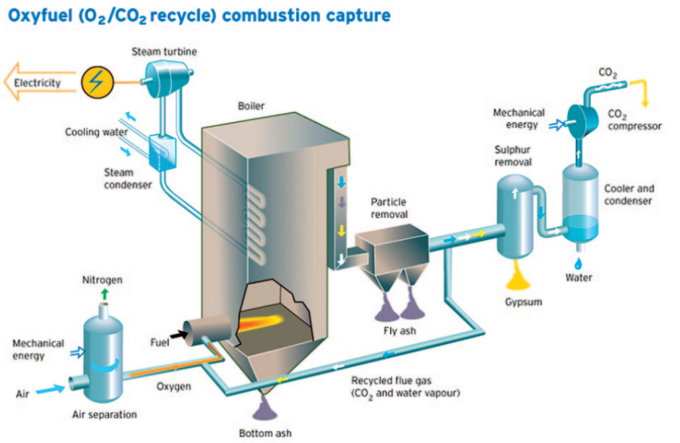
Figure 11: Simplified flowchart for an oxy-fuel power plant . (Source: Kjell-design / Vattenfall)
This method requires large quantities of oxygen that usually is extracted from air. Figure 11 is a simplified illustration on Vattenfall’s oxyfuel process where a separation unit delivers oxygen to the combustion chamber.

Slide 6


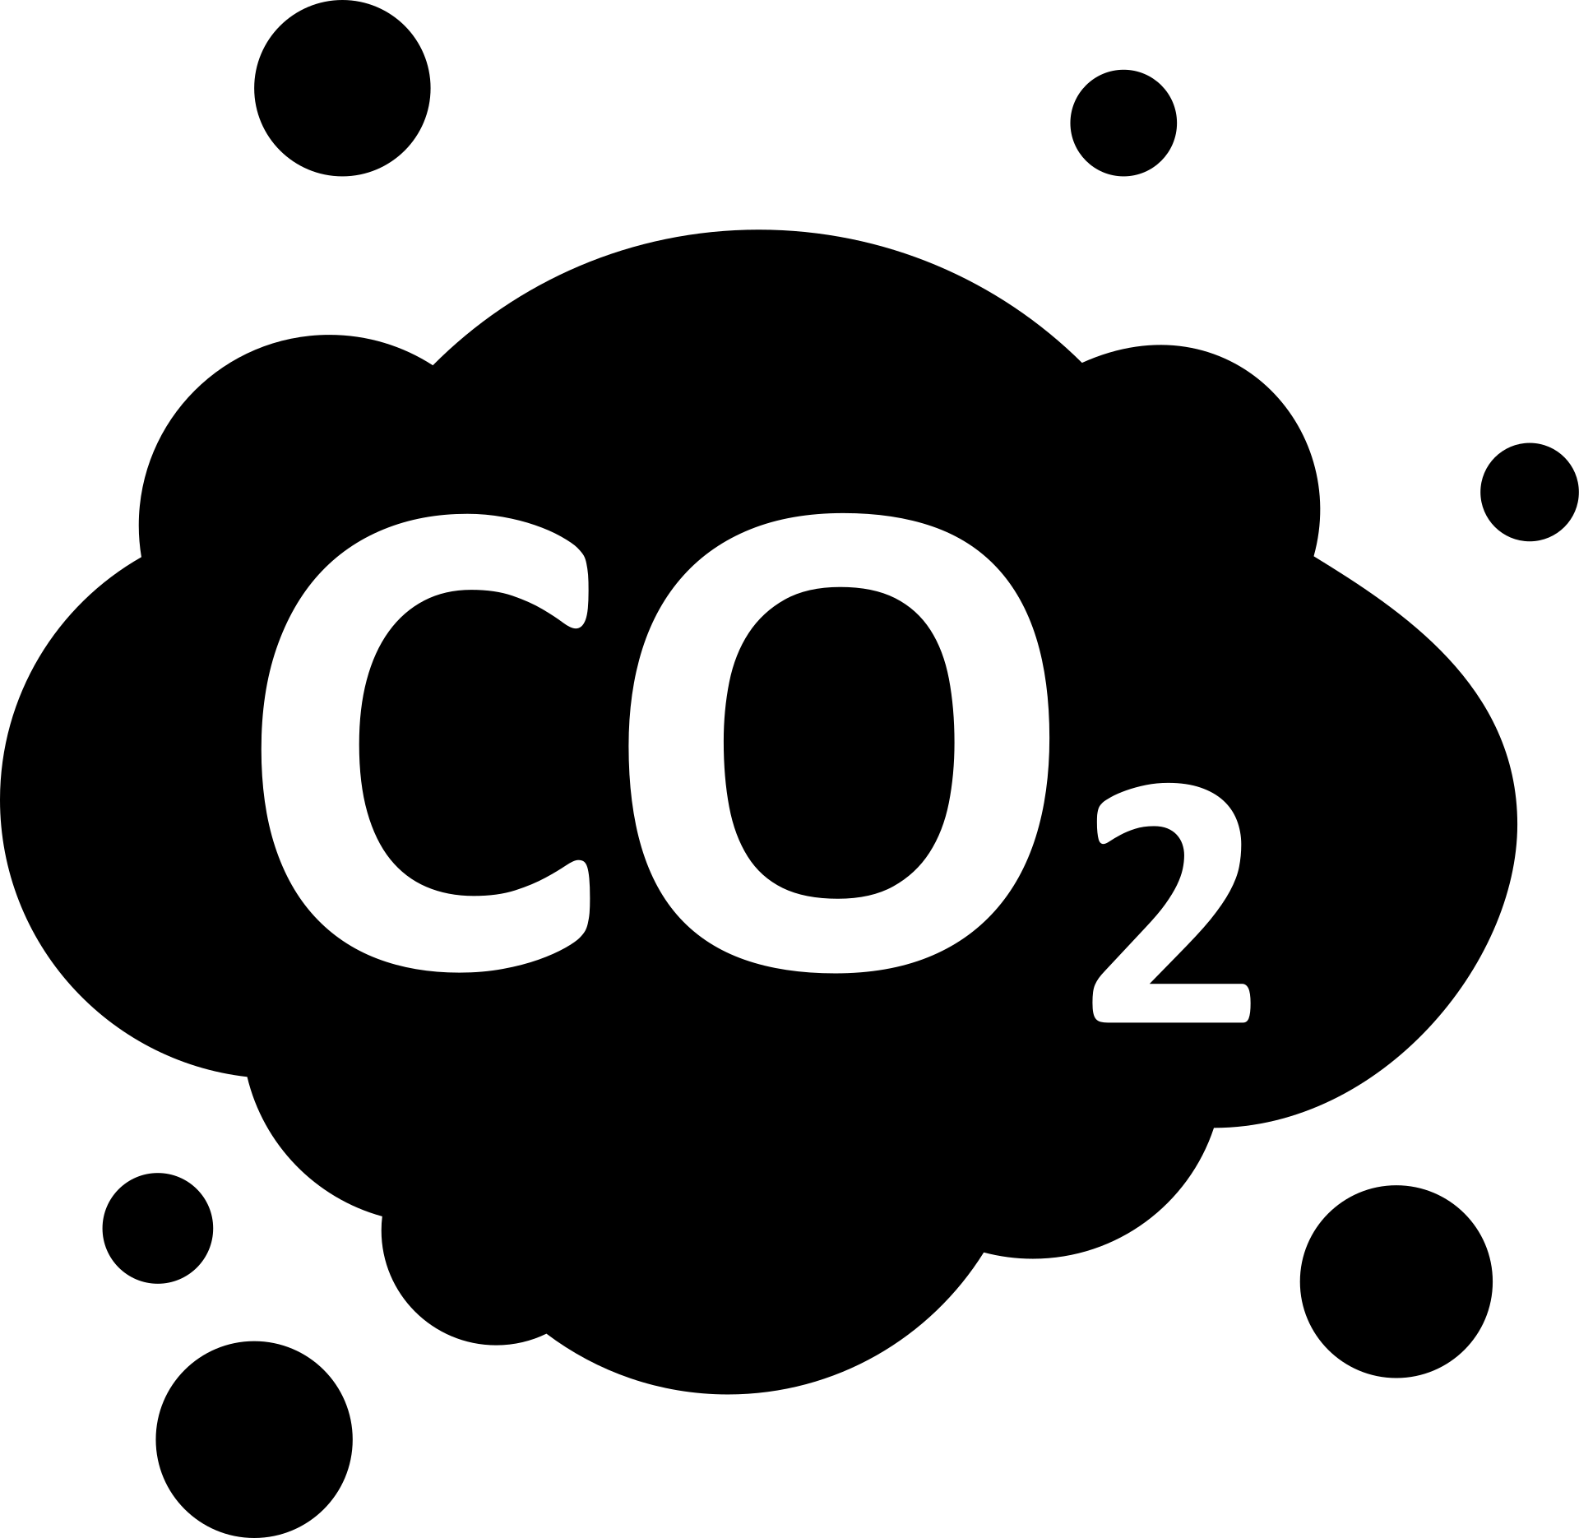
Combustion with pure oxygen emits virtually no NOx as there is no nitrogen from the air from which NOx could form; only small quantities of nitrogen in the fuel may lead to the forming of some NOx. The exhaust gas consists almost exclusively of CO2 and water vapour. The water vapour is removed by cooling the flue gas so that the water vapour condensates into liquid, leaving almost pure concentrated CO2 in the exhaust gas. The net flue gas, after cooling to condense water vapour, contains from about 80-98% CO2 depending on the fuel used and the particular oxy-fuel combustion process. This concentrated CO2 stream can be compressed, dried and further purified before delivery into a pipeline for storage. The CO2 capture efficiency is very close to 100% in oxy-fuel combustion capture systems. Impurities in the CO2 are gas components such as SOx, NOx , HCl and Hg derived from the fuel used, and the inert gas components, such as nitrogen, argon and oxygen, derived from the oxygen feed or air leakage into the system. The CO2 is transported by pipeline as a dense supercritical phase.

Slide 7
Supercritical Phase - A supercritical fluid is a phase that occurs for a gas at a specific temperature and pressure such that the gas will no longer condense to a liquid regardless of how high the pressure is raised.
The advantages of oxy-fuel technology are that it provides a relatively simple way to capture nearly all CO2 with virtually no emissions. It can be realised technically by using conventional steam turbine technology, and air separation is a wellknown and mature technology with many existing installations and suppliers. Oxy-fuel technology is equally suited for gas and coal power plants and can be an alternative for post-fitting when existing plants are modernised or rebuilt.

Slide 8
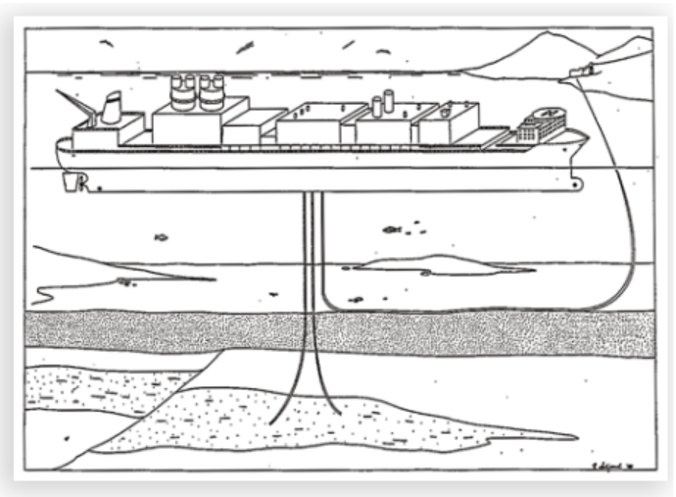

Figure 12: Offshore gas power plant with CO2 capture, from 1988 (Source: Holt & Lindberg).
Plans for an offshore gas power plant with oxy-fuel CO2 capture was made public as early as 1987. In many ways this marked the beginning of efforts to provide an alternative energy supply to Norwegian petroleum activity. In 1988 a report to Statoil contained a study of the concept, called “Environmentally friendly gas power combined with EOR” (Holt & Lindeberg 1988). The concept is illustrated in figure

Slide 9
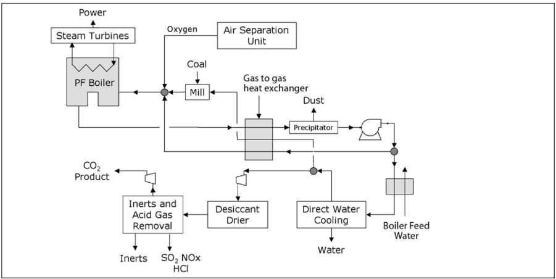
Oxy-fuel indirect heating - steam cycle
In these systems, the oxy-fuel combustion chamber provides heat to a separate fluid by heat transfer through a surface. It can be used for either process heating, or in a boiler with a steam cycle for power generation. The indirect system can be used with any hydrocarbon or carbon-containing fuel.
Figure 3.8 Schematic of an oxy-fuel, pulverized coal fired power plant.

Slide 10
Important features of the plants converted to oxy-fuel combustion :
• Burner design and gas recycle flow rate have been selected to achieve the same temperatures as in air combustion (compatible temperatures with existing materials in the boiler).
• The CO2 -rich flue gas from the boiler is divided into three gas streams: one to be recycled back to the combustor, one to be used as transport and drying gas of the coal feed, and the third as product gas. The first recycle and the product stream are cooled by direct water scrubbing to remove residual particulates, water vapour and soluble acid gases such as SO3 and HCl. Oxygen and entrained coal dust together with the second recycle stream flow to the burners.

Slide 11
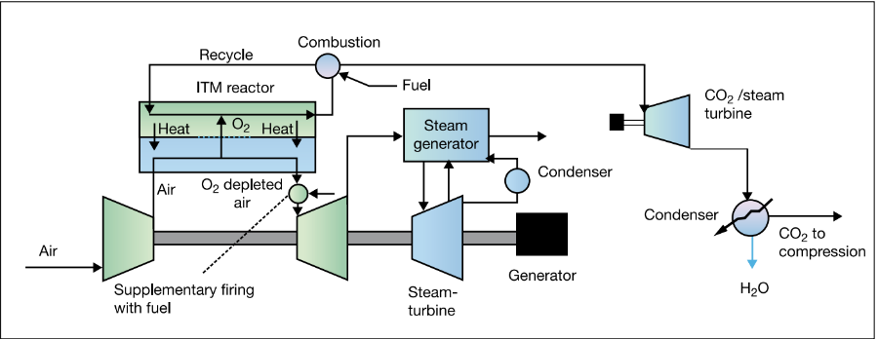
• The overall heat transfer is improved in oxy-fuel firing because of the higher emissivity of the CO2 /H2 O gas mixture in the boiler compared to nitrogen and the improved heat transfer in the convection section. These improvements, together with the recycle of hot flue gas, increase the boiler efficiency and steam generation by about 5%.
• The overall thermal efficiency is improved by running the O2 plant air compressor and the first and final stages of the CO2 compressor without cooling, and recovering the compression heat for boiler feed water heating prior to de-aeration.

Slide 12
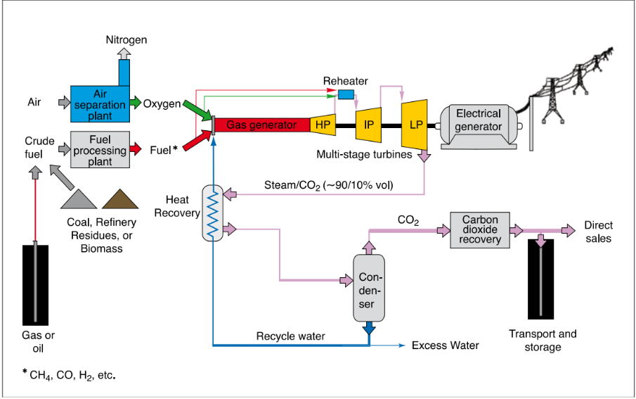
Oxy-fuel direct heating - steam turbine cycle
Figure : Principle of the Clean Energy Systems cycle. The combustion of the fuel and oxygen is cooled by injection of liquid-water, which is recycled in the process.

Slide 13
Current Status
Electrical generation efficiency in oxy-fuel plants may be higher than in conventional plants using combustion with air. But air separation and CO2 compression requires energy, leading to an overall loss in efficiency of about 12 percent. The power generation efficiency of a combined cycle gas power plant with oxygen combustion and CO2 compression is therefore 43-48 percent.
Current technology development envisages very high efficiency separation of NOx , SOx , and Hg, as part of the CO2 compression and purification system. Current cryogenic oxygen technology is showing continuing cost reduction based on improved compressor efficiencies, more efficient process equipment and larger scale plants. The new high temperature oxygen membrane could significantly improve power generation efficiency and reduce capital cost.

Slide 14
Current Status
However, several novel applications proposed for direct heating in steam turbine cycles or gas turbine cycles for power generation still require the development of new components such as oxy-fuel combustors, higher temperature tolerant components such as CO2 - and H2 O-based turbines with blade cooling, CO2 compressors and high temperature ion transport membranes for oxygen separation.
Oxy-fuel combustion applied to furnaces, process heaters, boilers and power generation systems is feasible since no technical barriers for its implementation have been identified. Early use of this capture technology is likely to address applications involving indirect heating in power generation and process heating, since these options involve the minimal modification of technologies and infrastructure that have hitherto been already developed for the combustion of hydrocarbon or carbonaceous fuels in air.

